Slide 1


Fuel control portable
GIT El Salvador

Slide 2
Mobile
Mateline

Slide 3
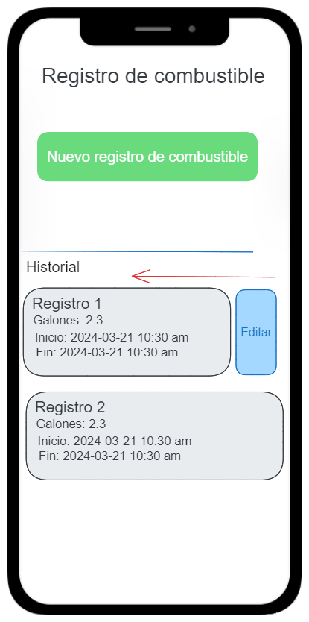
Main fuel page
Refuel activity list
Add new refuel activity

Slide 4
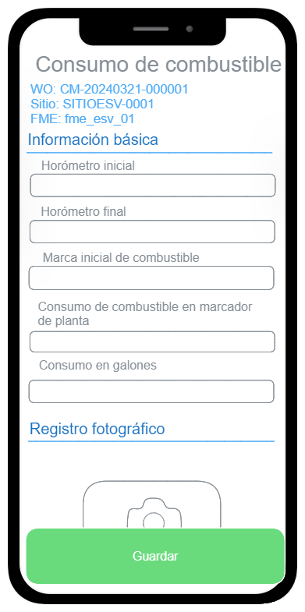
Fuel form
FME must fill the checklist of fuel consumption

Slide 5
PC page configuration

Slide 6
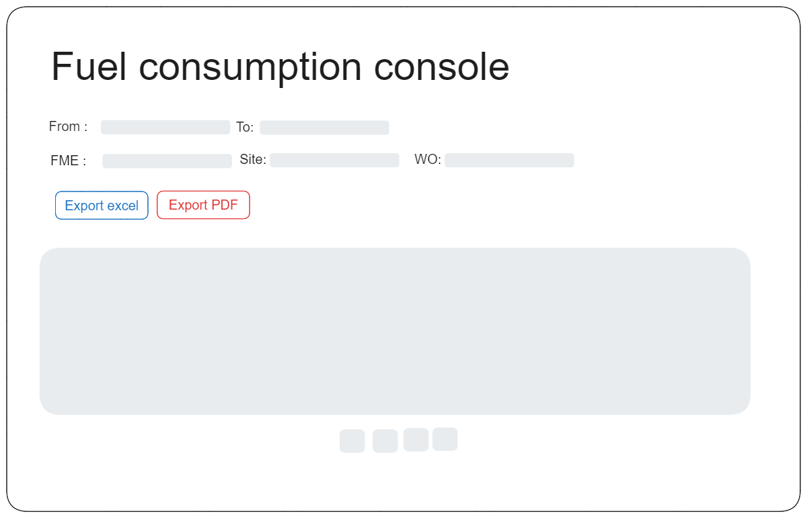
Report console
After work order completion web users can:
Generate PDF web report
Export Excel info
Second pase PDF

Slide 7
Second pase PDF report build
Web report

Slide 8
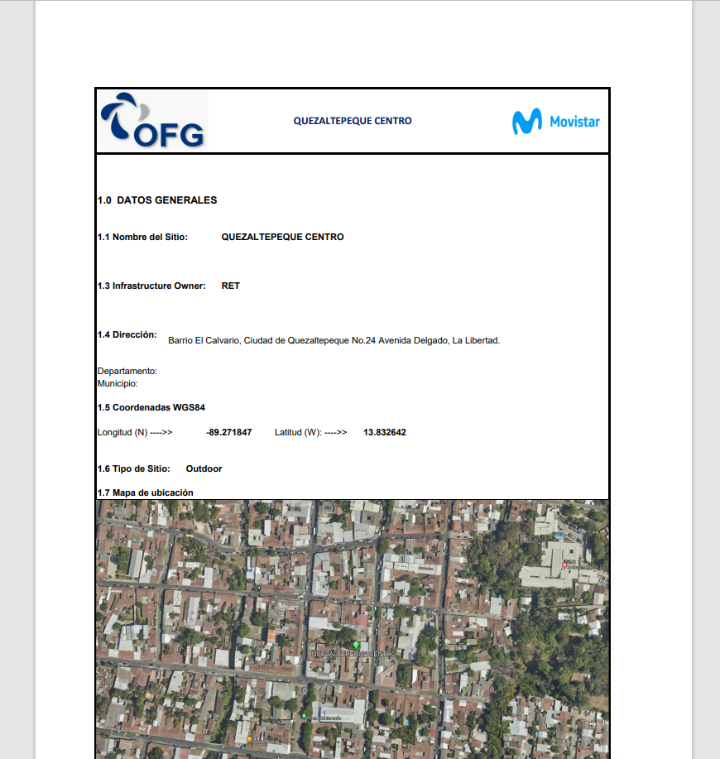
PDF web (second phase)
The web report can be displayed on web and be printed

Slide 9
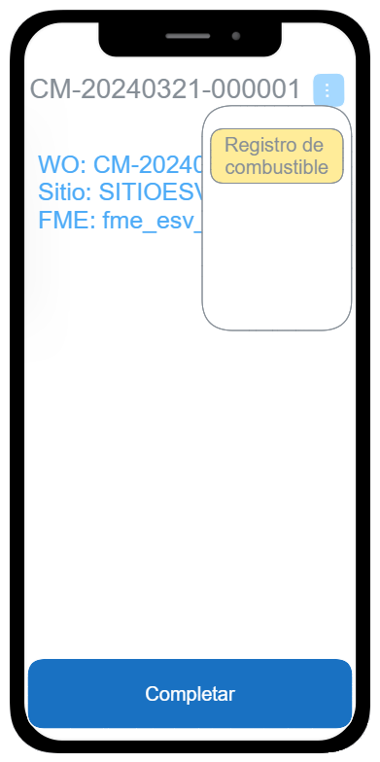
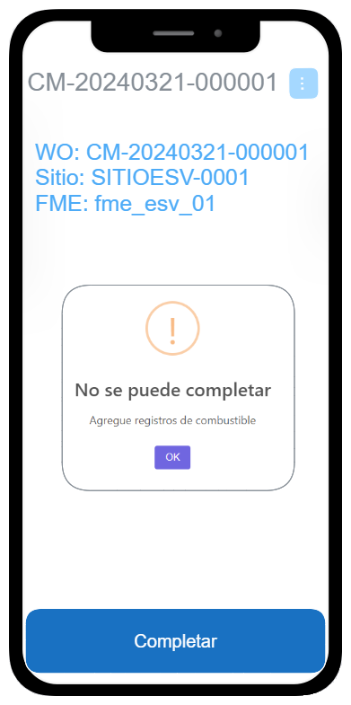
WFM integration
A button to go to refuel activity Will be available before complete the work order
If try to complete without fuel consumption register the system throws an error

Slide 10
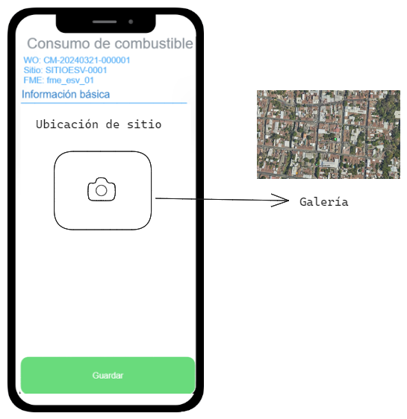
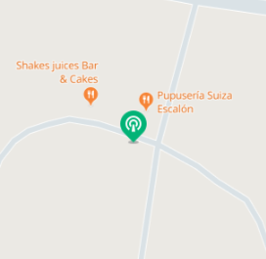
Map capture (second phase)
Proposal 1: Let FME upload from gallery
Proposal 2: Auto-generate in GDE
1. Take screenshot
2. ⚠️ If the Huawei MAP is not available the image can’t be generated

Slide 11
Work plan
Task | Duration
Mobile development | 5
Console development | 3
Map generation automation | 2
WFM integration | 2
Report development | 5
Testing | 1
Deployment (field usage monitor) | 2
Total | 13 working days

Slide 12



Copyright©2014 Huawei Technologies Co., Ltd. All Rights Reserved.
The information in this document may contain predictive statements including, without limitation, statements regarding the future financial and operating results, future product portfolio, new technology, etc. There are a number of factors that could cause actual results and developments to differ materially from those expressed or implied in the predictive statements. Therefore, such information is provided for reference purpose only and constitutes neither an offer nor an acceptance. Huawei may change the information at any time without notice.

